Slide 1



The development of Icelandic tourism terms of development and policy making
What can Greenland learn?
Future Greenland 2015
Growth and welfare – scenarios for the development of Greenland
Nuuk May 6-7th, 2015
Dr. Edward H. Huijbens
Research Professor
Icelandic Tourism Research Centre / University of Akureyri
edward@unak.is, 460-8930

Slide 2
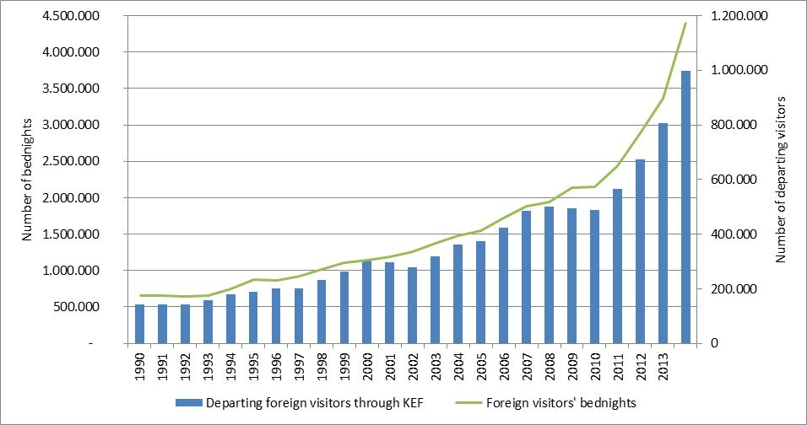
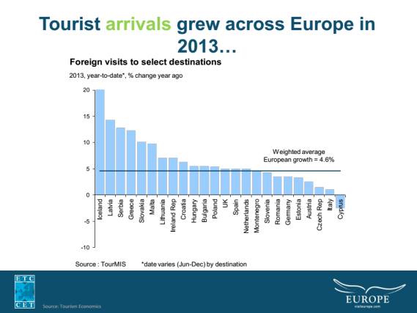
Guests to Iceland

Slide 3
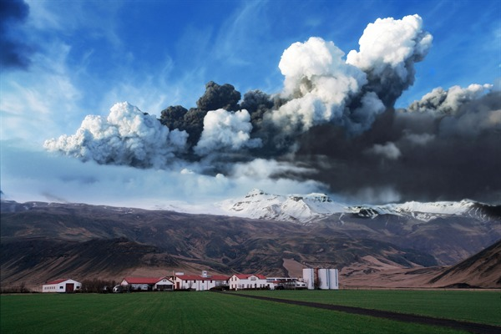
Eyjafjallajökull

Slide 4
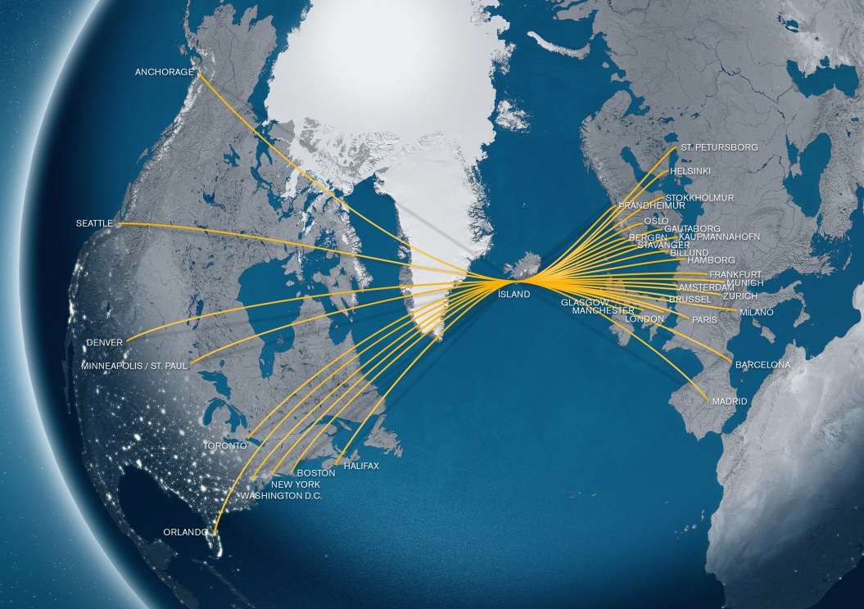
Icelandair route network

Slide 5
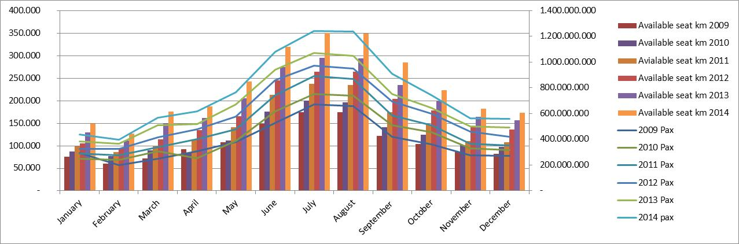
Icelandair Group
International flights
r=0,977

Slide 6
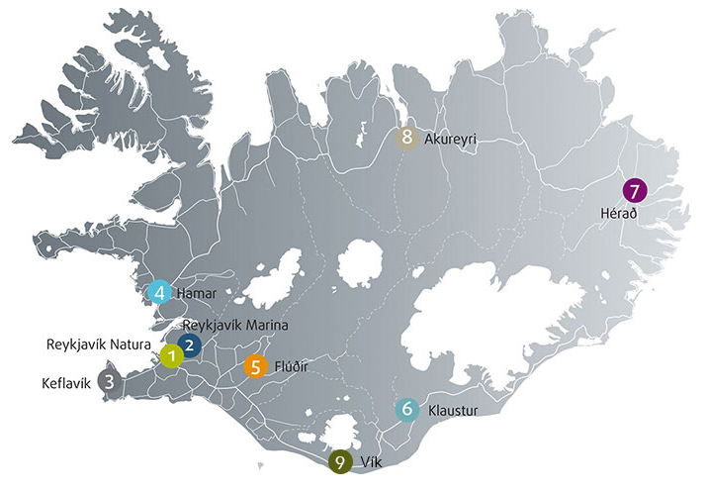
Icelandair hotel locations

Slide 7
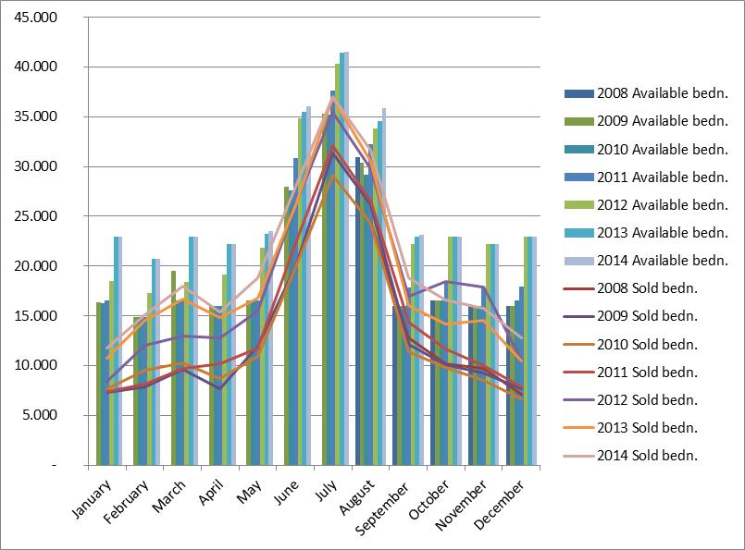
Icelandair Group
Hotels

Slide 8
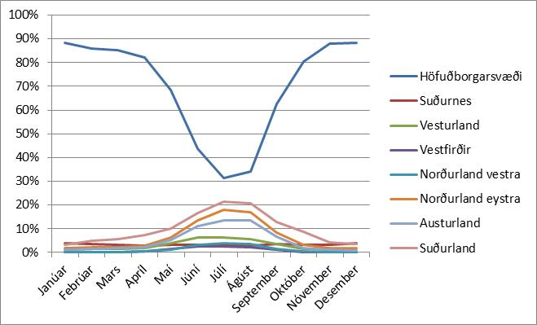
Bednights by foreign visitors 1998-2014
Average by regions

Slide 9
Gini coefficient for regional bednights pr. moth, pr. region

Slide 10
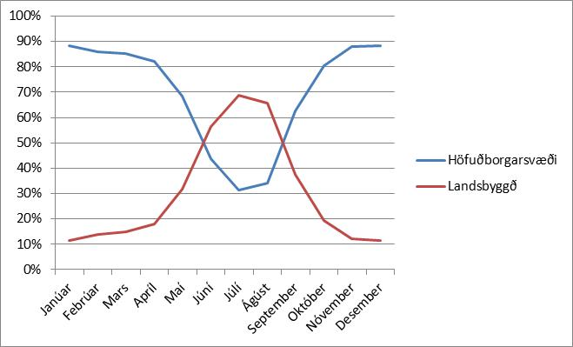
Tourism challenges
Ratio of total bednights by tourism regions in Iceland by months
average 1998-2014

Slide 11
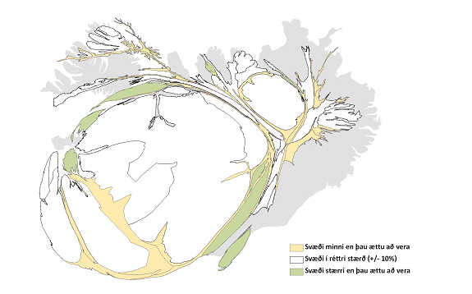
The regional challenges
Kristín Ágústsdóttir, 2012: Skiptir stærðin máli [does size matter], p. 54
Notes:
Yet the regions reflect days gone by ...
The regional development agencies are reflecting voting districts as they were defined in 1959. Things have changed and this picture goes to show the overall demography of Iceland today and how regions are larger or smaller then they should be in terms of the demographic representation.

Slide 12
Icelandair route network

Slide 13
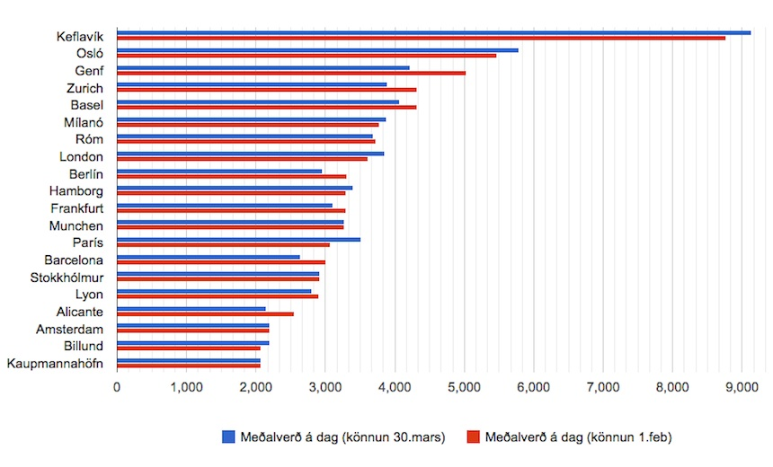
Getting from Keflavík
Average prices for renting a car – spring 2015
http://turisti.is/innblastur/2106-afram-langdyrast-ad-leigja-bila-a-islandi

Slide 14
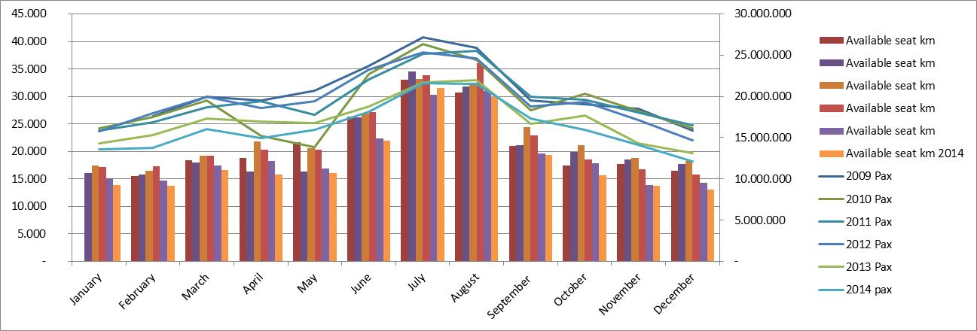
Icelandair Group
Domestic/regional flights

Slide 15
Key is connectivity
Page, 2009: Transport and Tourism, p. 262

Slide 16
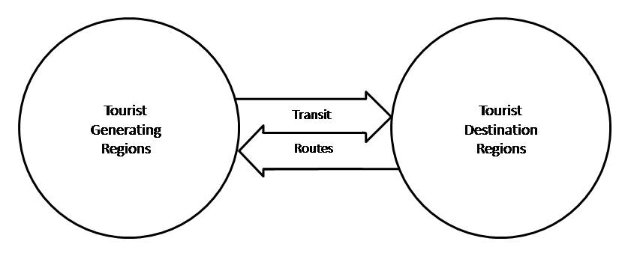
The tourism system
Leiper, 1979: The framework of tourism: towards a definition of tourism, tourist, and the tourist industry, p. 397

Slide 17
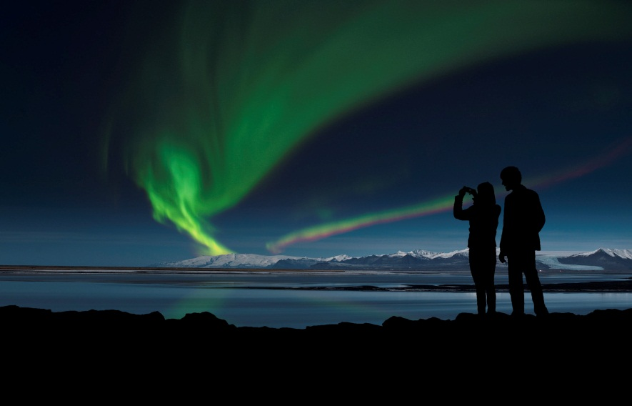
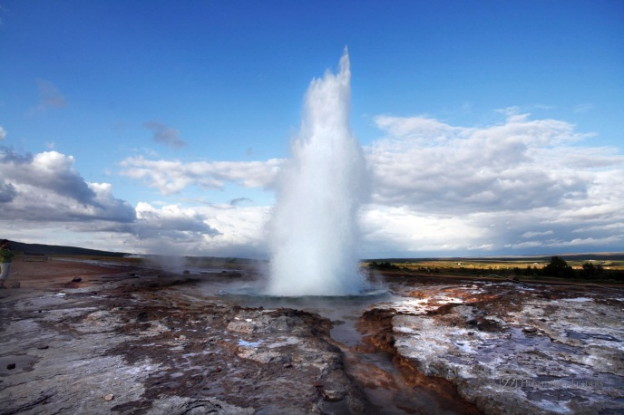
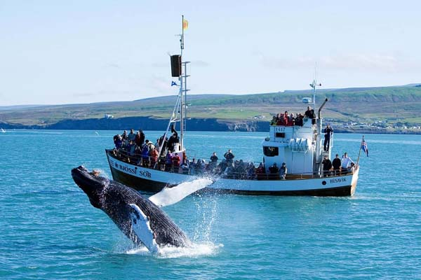
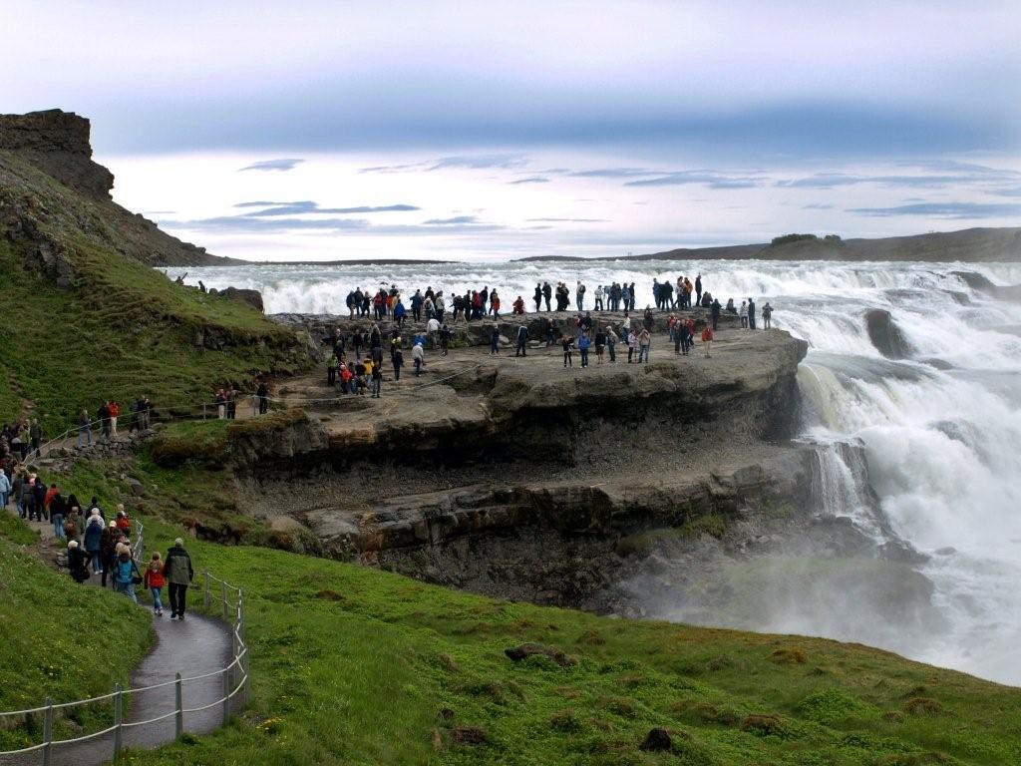
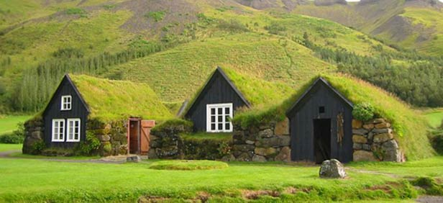
The resource

Slide 18
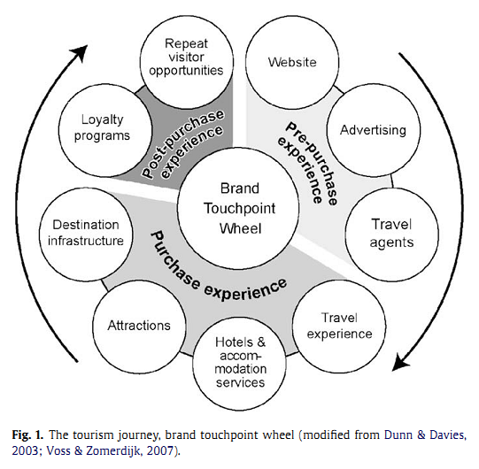
Purchase decisions
Shaw and Williams, 2009: Knowledge transfer and management in tourism organisations, p. 327

Slide 19
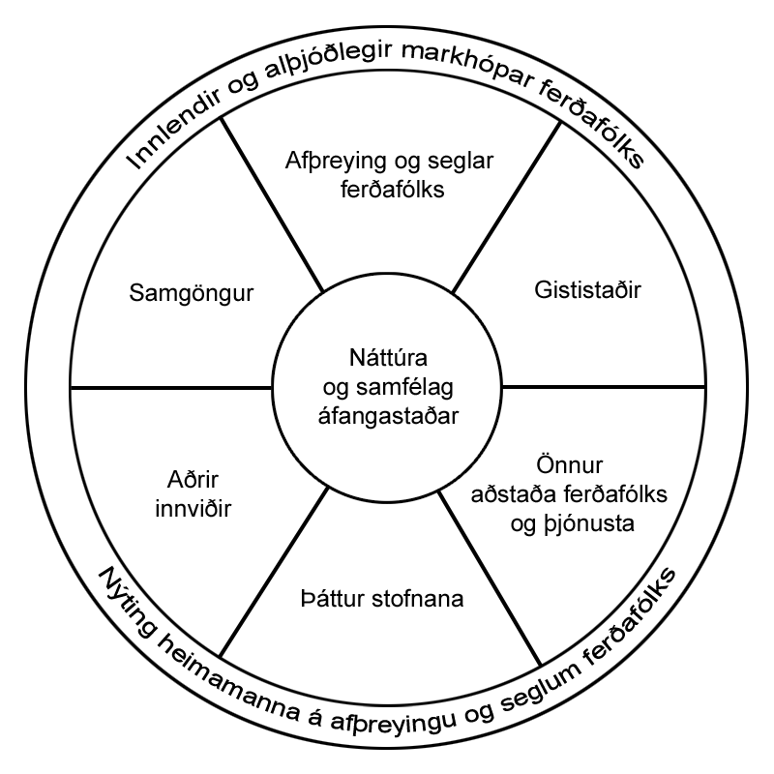
System with institutions
The destination
Source market
Target groups
Products
Products
Target groups
Communication
Products
Target groups
Products
Transportation
Products
Target groups
Ferðamálastofa
Íslandsstofa
Nýsköpunarmiðstöð

Slide 20
My advice to the policy makers
Define the role of institutions and their communication pathways.
Ensure coherent and quality data gathering on one neutral hand (Statistics Iceland).
Set up a resource inventory based land-use strategy.
Define the role of education in tourism and its setup from vocational training to research work.
Demand compliance in quality assurance schemes.
Define revenue sources for the public from the industry, using existing system of taxation to levy charges.
Join up transport infrastructure in the country.
Define industry success measures beyond quantitative and countable means.
Ensure third party review of policy making in the industry.

Slide 21
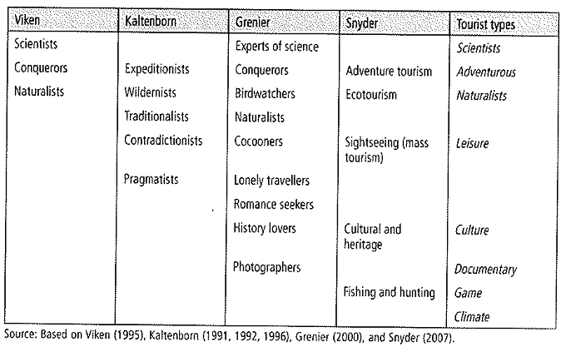
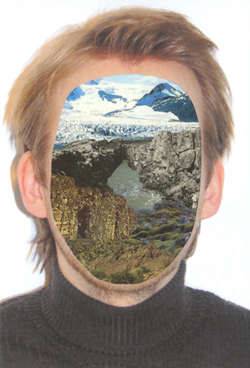
Tourism types of polar tourism
Án áfangstaðar/Without Destination
From: Gelter 2011: Polar Tourism a tool for regional development, p. 236

Slide 22
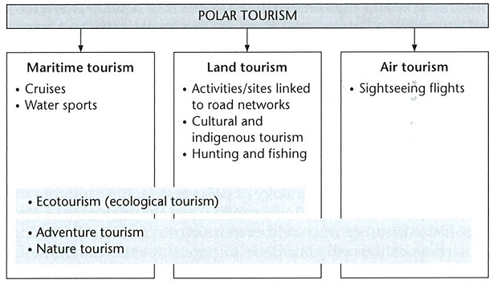
Polar tourism branches
Grenier, 2011: Conceptualization of Polar Tourism
In: Polar Tourism. A tool for Regional Development, p. 66

Slide 23
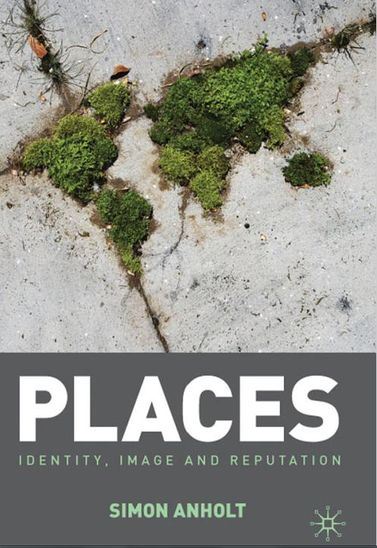
Marketing destinations
strategy
substance
symbolic action
structure
Anholt, 2010: Places, p. 13, see also Hjalager, 2011: The invention of a Danish well-being tourism region: Strategy, Substance, Structure and Symbolic Action.

Slide 24
System with institutions
The destination
Source market
Target groups
Products
Products
Target groups
Communication
Products
Target groups
Products
Transportation
Products
Target groups
Ferðamálastofa
Íslandsstofa
Nýsköpunarmiðstöð

Slide 25



The role of media
Sharing and social media
Tourism prosumption and the changing structure of tourism services

Slide 26
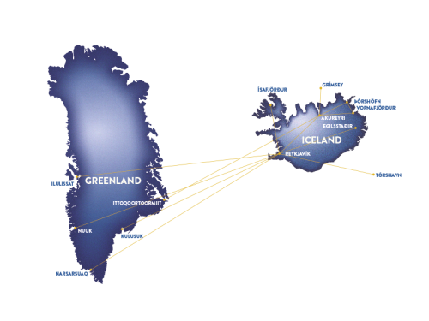
Air Iceland route network

Slide 27
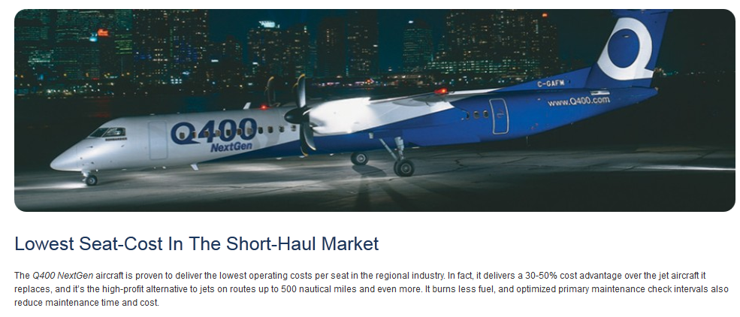
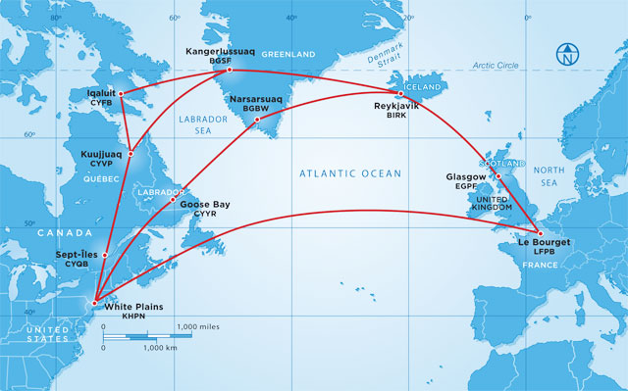
New fleet

Slide 28
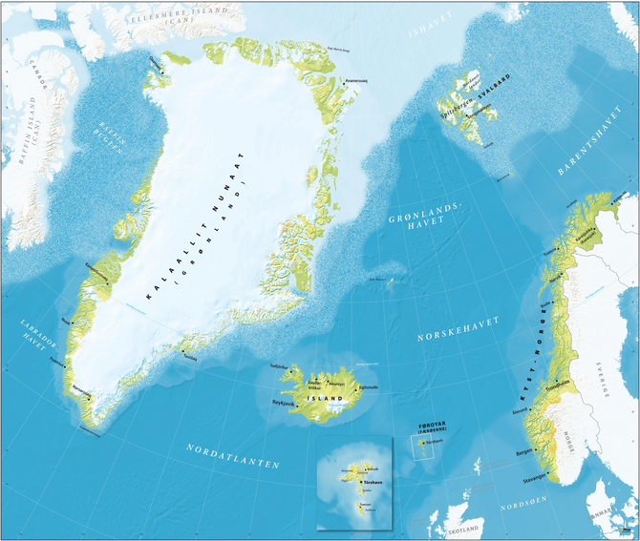
Vest norden?
Despite the various distinct approaches to define the characteristics and problems
of the West Nordic region, a more substantial discussion on why Vestnorden exists as a region, is to our knowledge absent, and Vestnorden seems to be taken for granted as a region, so in what sense or to what extent is the West Nordic a region at all?
Eythórsson and Hovgaard, 2013: Vestnorden. A functional region?, p. 144
Icelandic Review of Politics and Administration 9(1): 139-154
the problem here is that the West-Nordic countries follow different routes of influence on matters of great common interest, events which may push the West Nordic council even more on the outset
Eythórsson and Hovgaard, 2013: Vestnorden. A functional region?, p. 152

Slide 29
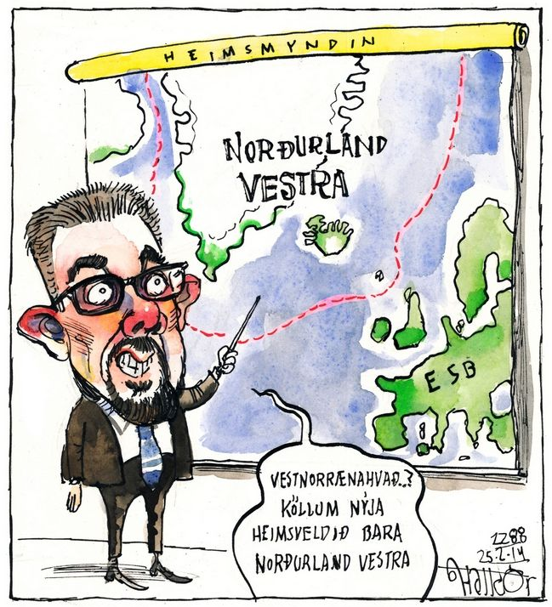
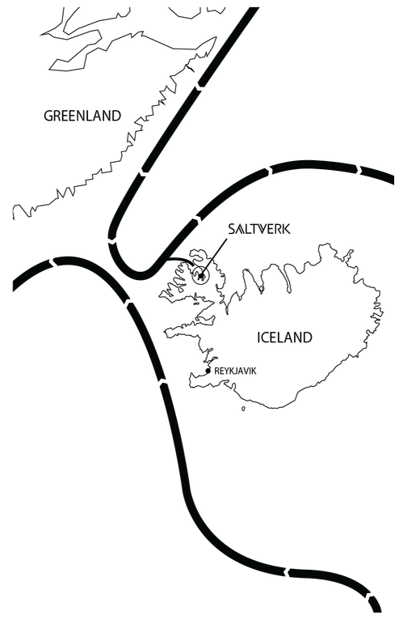
A West Nordic Development Strategy for Tourism? (NORA Annual Report, 2014)
Northern lights and midnight sun, fjords, icebergs, whales, puffins, volcanoes and infinite unpopulated wilderness. The NORA countries are full of tourist attractions. The region’s unique nature makes tourism an important and natural part of the region’s economic growth potential. The tourism industry, especially in Iceland, is growing vigorously.
NORA annual report 2013, p. 13

Slide 30
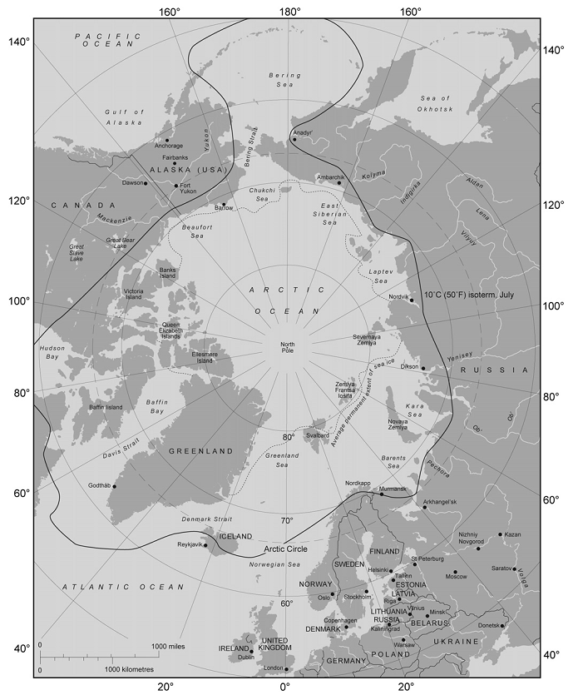
Arctic sovereignty
The Arctic could slide into a new era featuring jurisdictional conflicts, increasingly severe clashes over the extraction of natural resources, and the emergence of a new ‘great game’ among the global powers.
Berkman and Young, 2009: Science, 324, p. 339
states use tourism as an instrument to shore up international recognition and support for declarations of sovereignty
Timothy, 2010: Contested Place and the Legitimization of Sovereignty Claims Through Tourism in Polar Regions, p. 288

Slide 31
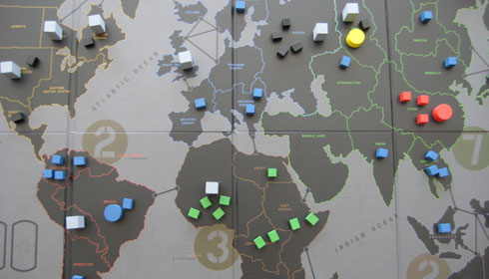
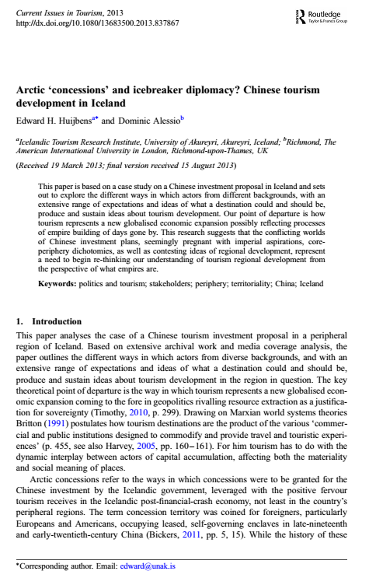
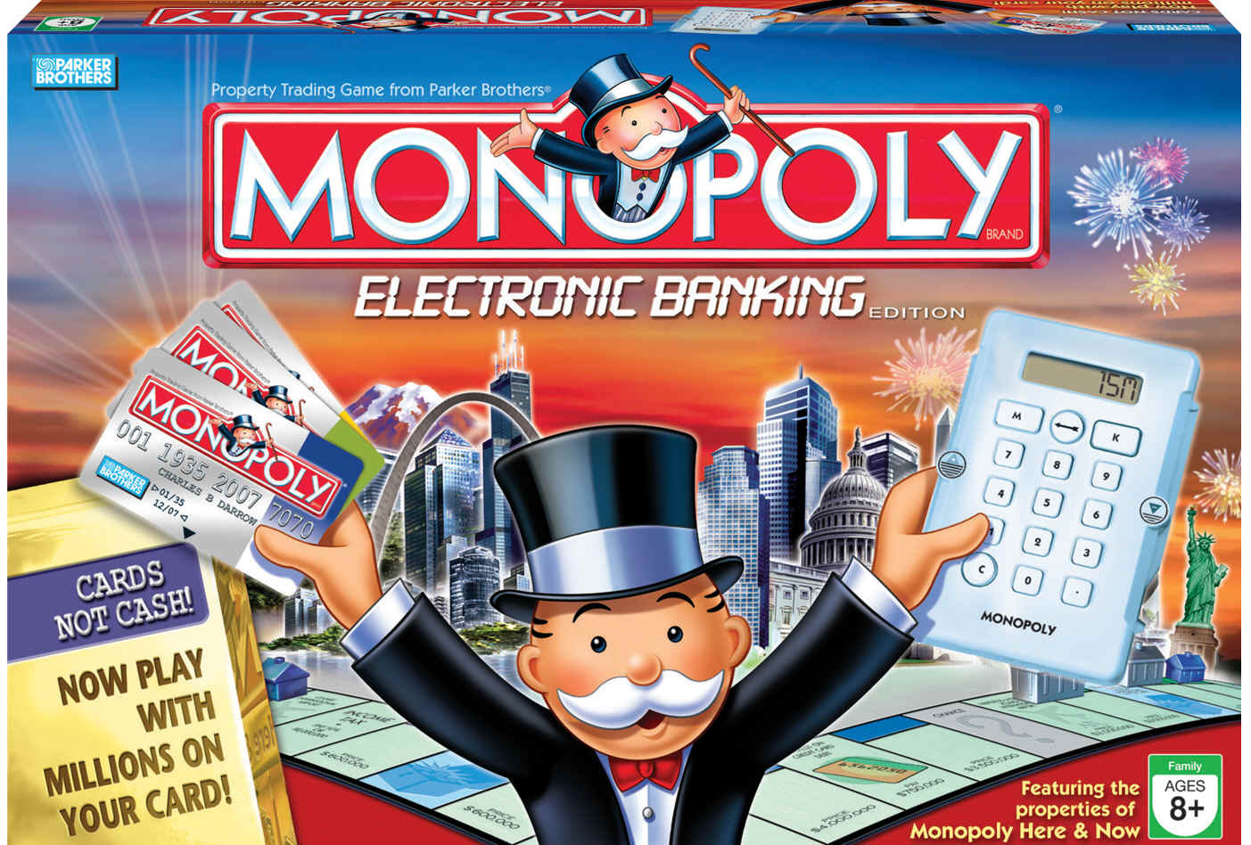
Monopoly imperialism?
Notes:
So it is possible, therefore, for a hegemonic power to be hidden in the guise of an apparently private business venture like Nubo’s. This is a potential example of what George Soros called the ‘unholy alliance between government and business’ (quoted in Docherty, 2012, p. 43).
There is, nevertheless, one other method by which imperial states could expand, one which has been neglected by historians of empire: they could be purchased. In other words, empire appears less as a contest of the Parker Brothers/Hasbo’s board game Risk and more as a game of Monopoly. A tendency to overlook expansion by purchase could in fact be one reason why the United States is not often considered to be a 19th Century imperial power (Mann, 2008, p. 7). All the while the United States remains a champion finalist at the ‘Great Game’ of monopoly imperialism, exemplified by the territorial purchases of Louisiana (1803), Gadsden (1853), Alaska (1867) and the former Danish West Indies (1916). As Charles Sumner, Chairman of the Senate Foreign Relations Committee at the time of the Alaska Purchase, admitted: ‘Our territorial acquisitions are among the landmarks of our history… There are few anywhere who could hear of a considerable accession of territory, obtained peacefully and honestly…’ (Sumner, 1867, pp. 12-13).

Slide 32
Lessons to be learned
Strategically define tourism resources based on a resource based inventory and land use plan integrated with well articulated transport networks.
Selectively target the marketing message to defined market segments, based on in-depth research
Have a democratically led vision of tourism futures for the country – not industry interest driven

