Slide 1
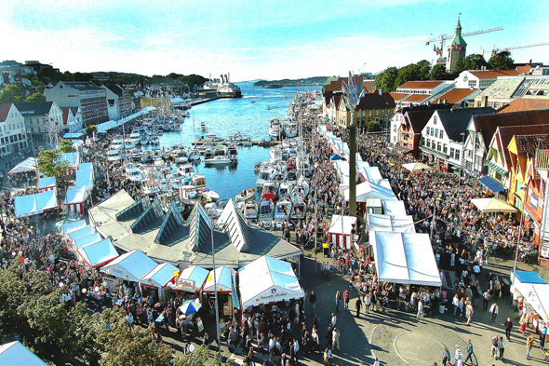
Improving guest satisfaction by using The Meal Experience Model

Slide 2
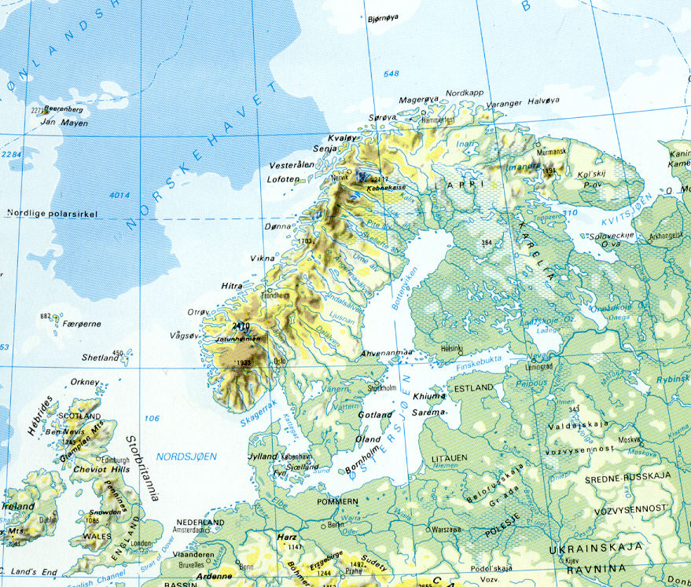
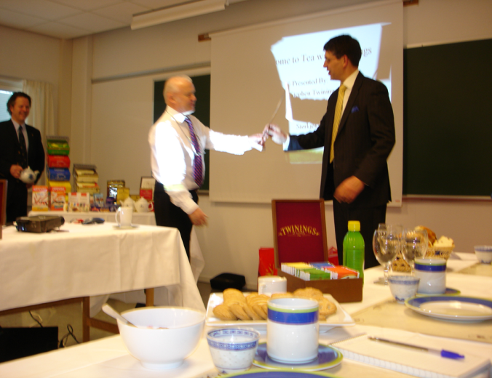
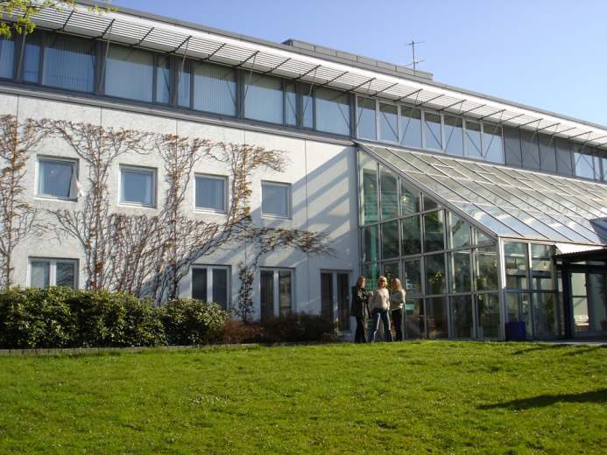

Slide 3
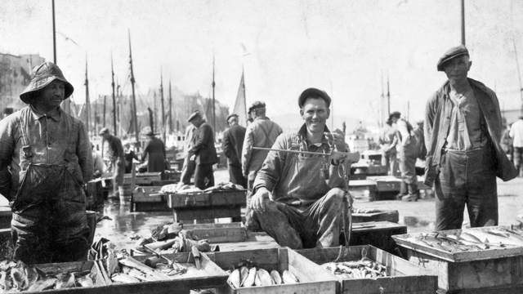
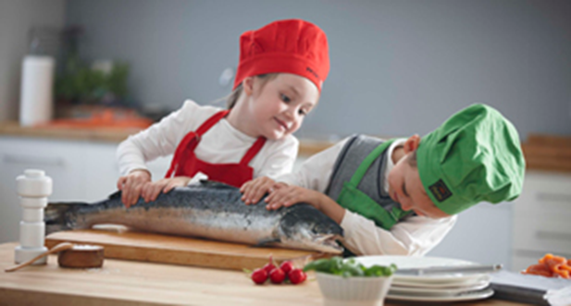
The role of meals in tourism – some assumptions
People consume 3 – 5 meals per day
Being taken in, the meal intrudes on one’s body in a most intimate way
The meal allows the person to get in intimate touch with the mundane, ordinary or unique meal experiences and food culture of a place
Food and meal outlets are windows to exhibit everyday life, food, food culture and culinary arts

Slide 4
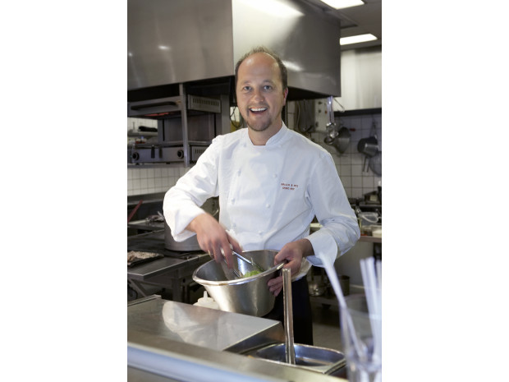
Philosophy of Gladmatfestivalen 2013
“Every day I shall feel excitement for food, meals and beverages
If not, I finish the day with a fine old cognac and get excited anyhow
One should feel that life is good due to food…”
Trond Moi, chef and restaurant chain owner (Bølgen & Moi)

Slide 5
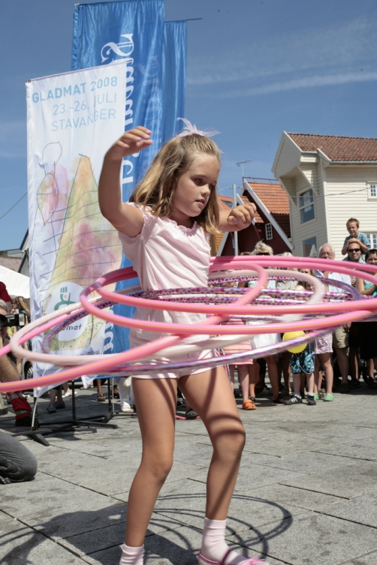
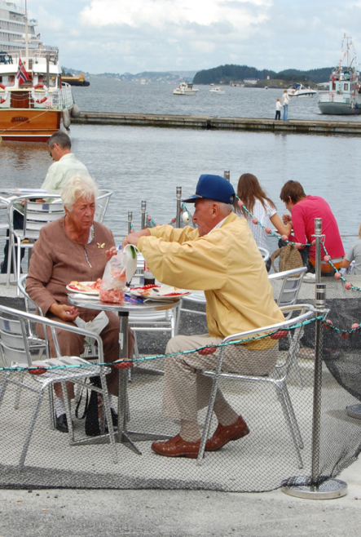
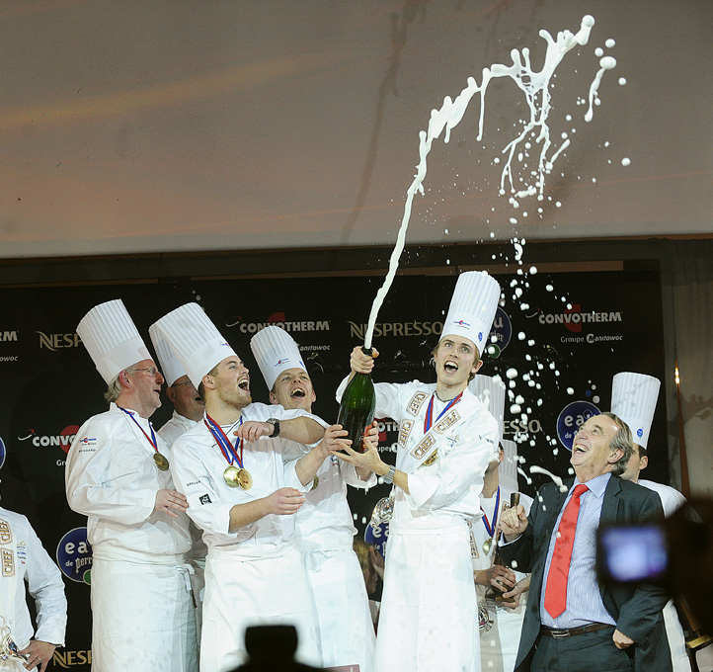
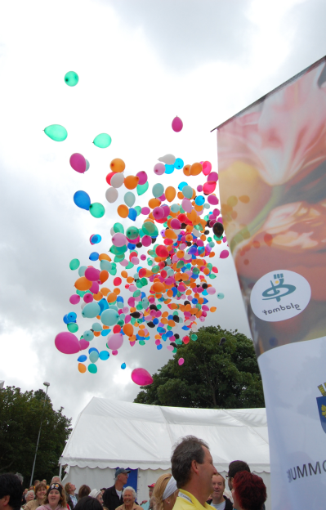
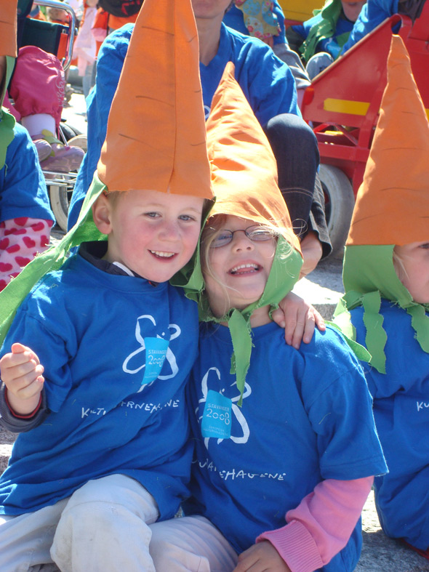
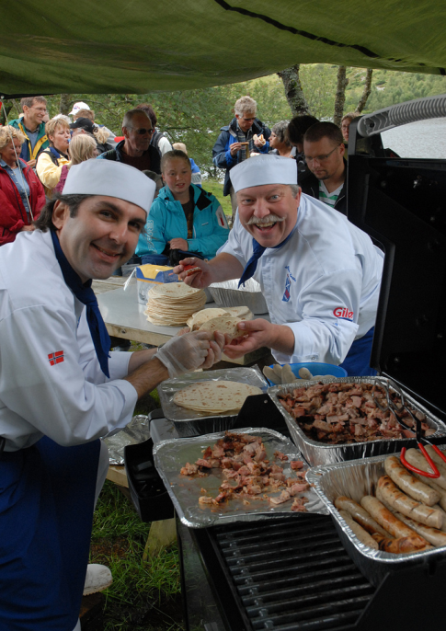
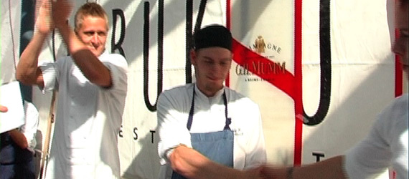
“Festivalisation”

Slide 6
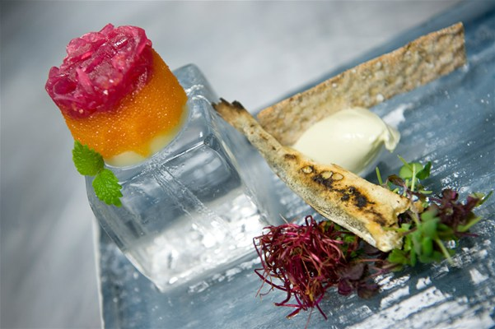
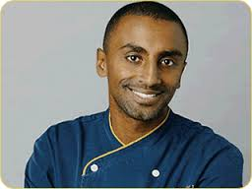
From fine dining to fun dining (Marcus Samuelsson at Gladmatfestivalen 2013)
Obama’s favourite chef
Humour, friendly, gentle and informal ambience
Meals based on short travelled raw materials
Mixing cultures and tastes
Meals back in the hotel: ”Kitchen and Table”
"My first inspiration came from my grandmother. As I learned more, I always went back to her because of her passion. Also, early on she always questioned me to make sure that this is what I really wanted to do."

Slide 7
“Foodies”, and food and meal tourism
“A Foodie is a person who is very very very interested in food. Foodies are the ones talking about food in any gathering – salivating over restaurants, recipes, radicchio. They don’t think they are being trivial – Foodies consider food to be an art, on a level with painting or drama.”
(Barr & Levy (1984) The Official Foodie Handbook. London: Ebury Press).
Number of visitors
L
H
Food interest

Slide 8
Characteristics of “Foodies” (Vujicic, Getz & Robinson, 2013)
Travel much for food and meal experiences
Work(ed) in food and meal related businesses
Income above average
Mainly middle-aged “empty-nesters”, couples
Top cities: Paris, Rome, NY, and Barcelona
Trusted sources of information:
Friends and relatives / word-of-moth
Official destination web page
Guide books
Trip Advisor and other social media
Activities preferred: Enjoy
Regional cuisine in local restaurants
Farmers’ market and look for fresh food
A nice romantic dinner
Attend food festivals / events

Slide 9
Serious food and meal tourists (Andersson & Mossberg, 2013 submitted)
Food and meal experiences the main focus of travel behaviour
Personal qualities - Involvement / devotion
Importance of food
Avoidance of risk
Symbolic value of food
Enjoyment value of food
Motivational and behavioural effects
Gastronomic identity formation (values, recognition)
Desire for healthy food and meals
Desire for locally produced food and meals
Interests for food tourism
Interests for visiting food events

Slide 10
The Meal Experience Model (Kai Victor Hansen, 2005)
The room, view, noise, cleanliness, atmosphere
The management
The food and beverages
The meeting (staff competence)
The other guests

Slide 11
Progression of economic value creation
“Production” advancements
Facilitate “transcendence”
Stage for experiences
Deliver services
Produce goods
Extract commodities
Time
(Modified from Pine & Gilmore, 1999)

Slide 12
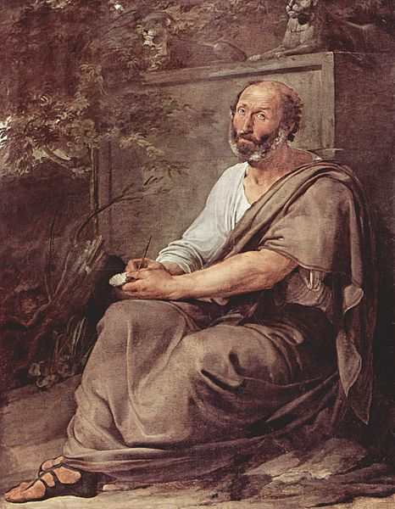
Hedonic vs. eudemonic pleasure
Pleasure is the only good in life, and the hedonist strives for maximising “net pleasure”
(= total pleasure –
the strain for achieving it).
Autonomy
Personal growth
Self acceptance Meaningful mastery
Positive relations
High
Hedonic
pleasure
Low
Aristotele
Low
High
Eudemonic pleasure

Slide 13
Flow (Csikszentmihalyi)
High
Tension
Stress
Flow
Demands
Worry
Control
Apathy
Boredom
Relaxed
Low
Low
Competence and resources
High

Slide 14
Experience – distinct from everyday life (Pine & Gilmore, 1998)
Absorption
Entertain-ment
Educational
Passive par-ticipation
Active par-ticipation
Aesthetics
Escapist
Immersion
Memories of yesterdays’ experiences
Expectations for future
Expectations for future trip / event, planning
Memories
Now
Time out of time

Slide 15
Emotions and strength of stimulation (Baloglu and Brinberg, 1997)
Strongly stimulating
Scared
Excited
Unpleasant
Pleasant
Boring
Relaxed
Not stimulating
Memories of yesterdays’ experiences
Expectations for future
Expectations for future trip / event, planning
Memories
Now
Time out of time

Slide 16
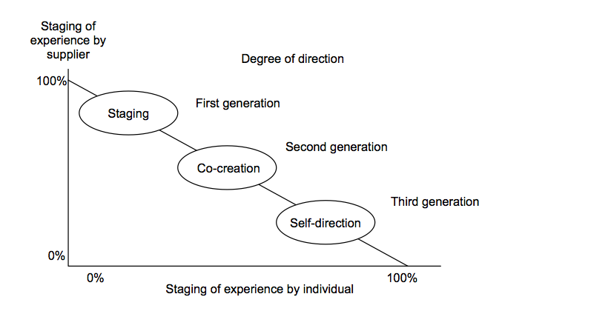
From staging experiences to experiencescapes for “shared self-direction”
Co-creation with fellow travellers
(Bosjwiik et al, 2007).

Slide 17
Newness and Meaning
Identity
Sense of belonging
In need for interpretation / Search for Adventure
(Neophilia)
Meaningful
No meaning
Anomia
Confused
Familiar
New

Slide 18
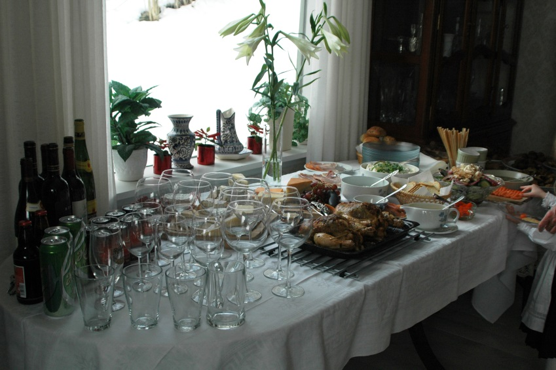
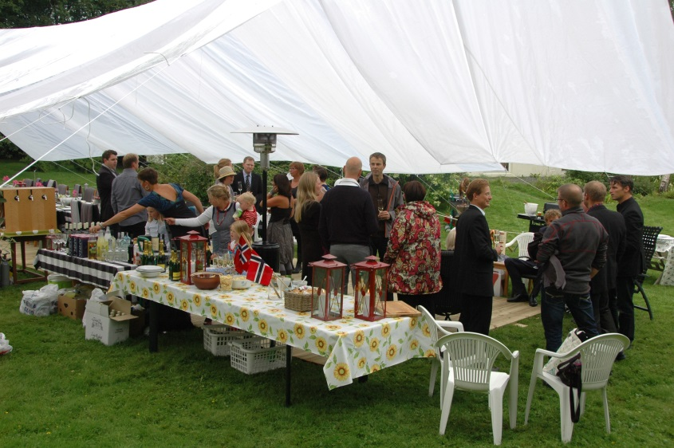
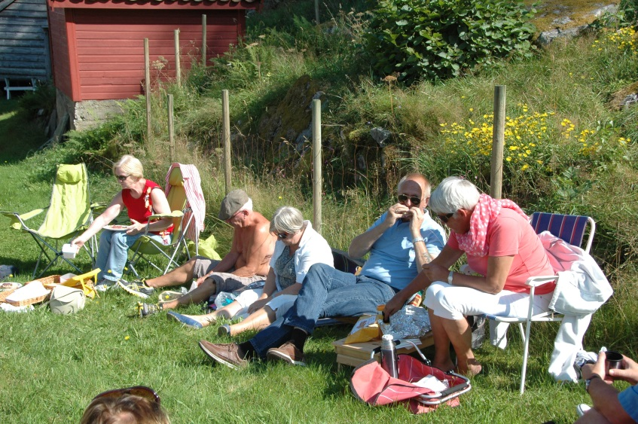
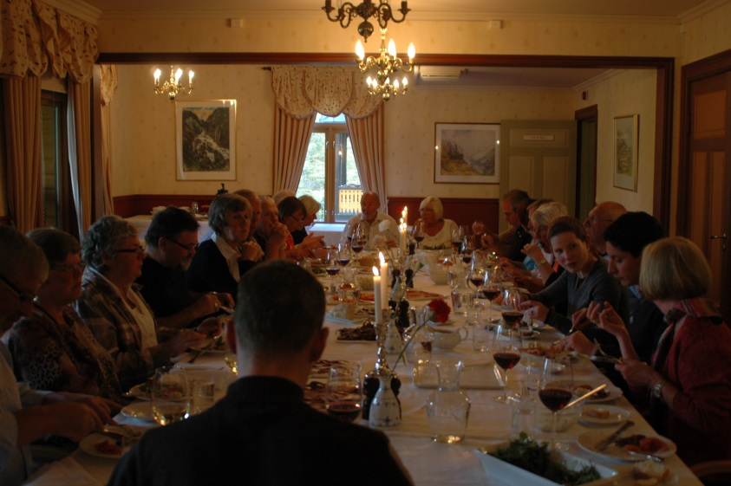
Can any room do?

Slide 19
Boswijk’s concept of “Meaningful experiences” (Boswijk et al., 2007)
Boswijk, Thikssen and Pelen (2007):
For “meaningful experiences”, the key word is emotions
These emotions, when strong and complex, can lead to more meaningful experiences (“Erfahrung”), which in contrast to “ordinary” experiences (“Erlebniss”) becomes more memorable.
Oh et al. (2007, p. 122):
enjoyable, memorable, engaging encounters

Slide 20
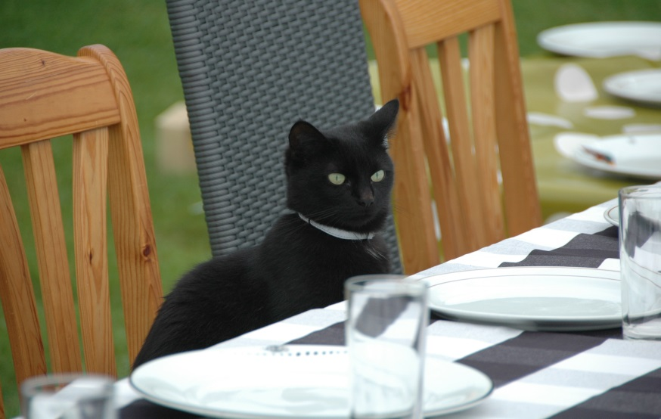
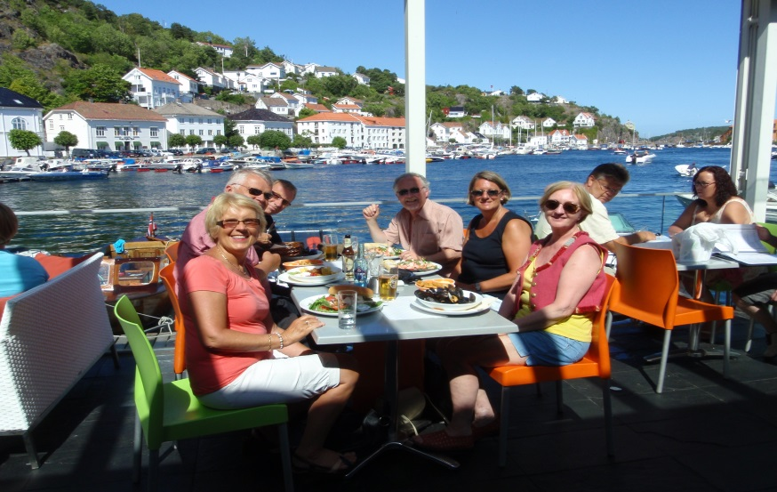
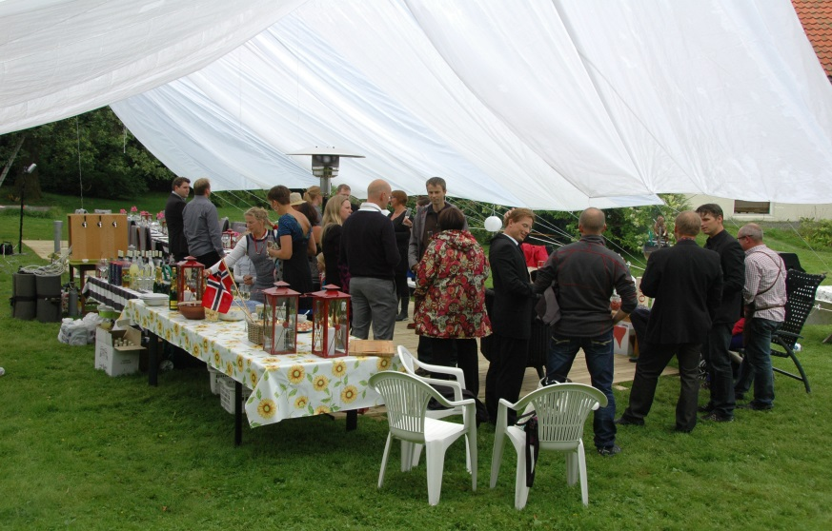
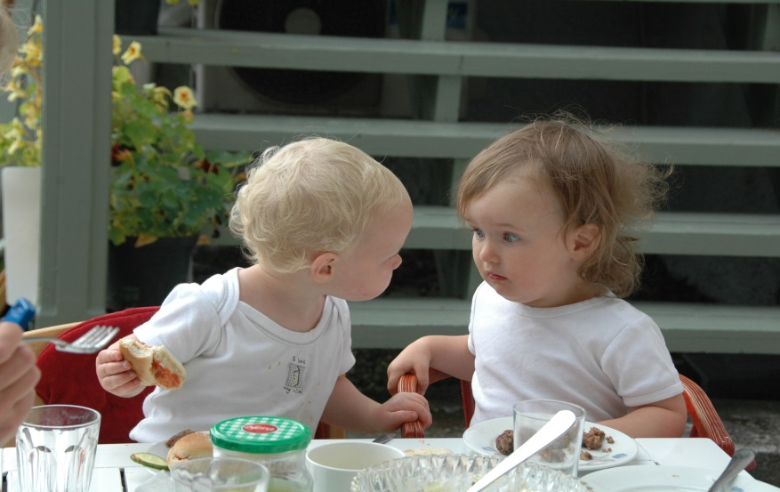
The other guests

Slide 21
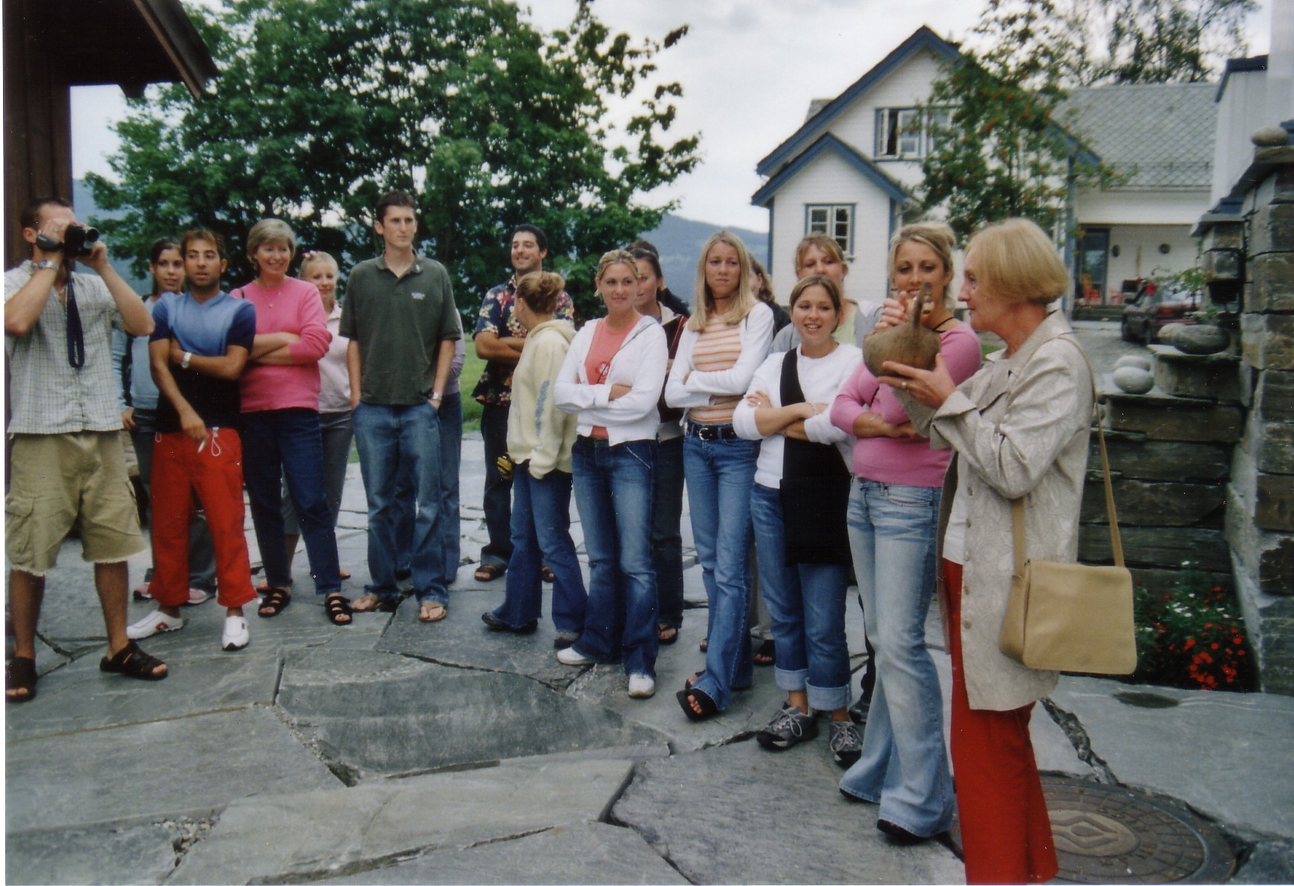
The meeting between the guest and the establishment (welcoming and staff competences)

Slide 22
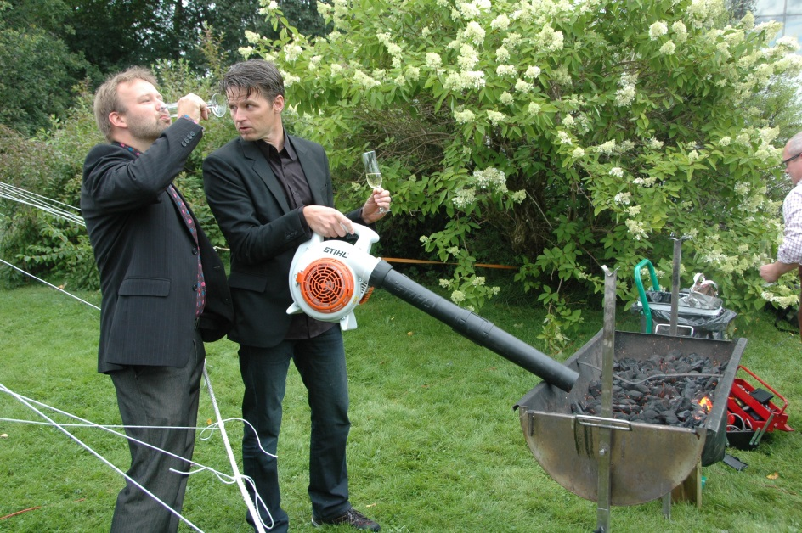
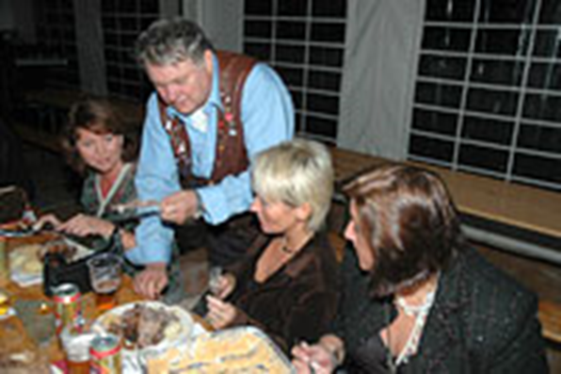
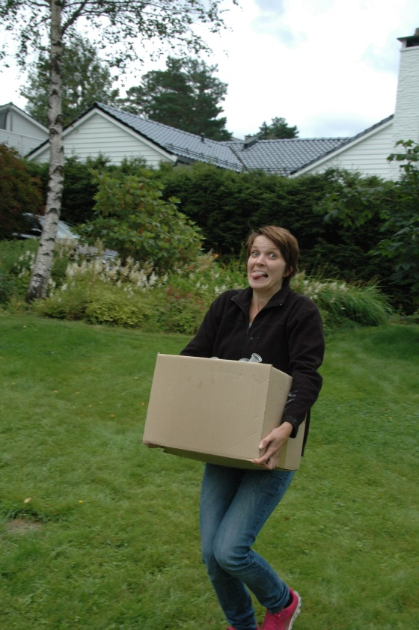
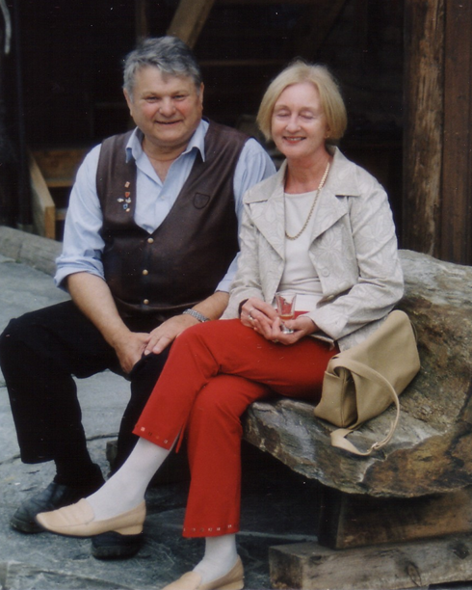
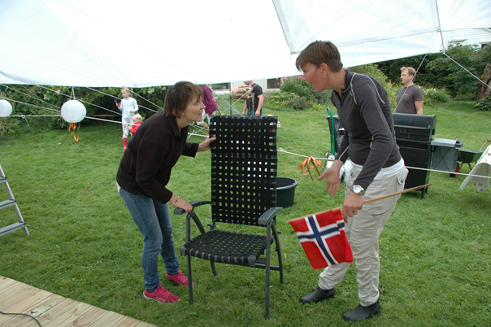
Workforce

Slide 23
Changes in proportion of non-ethnic Norwegian workforce 2000 – 2010 for restaurants and hotels compared to all other industries

Slide 24
Hotel and restaurant staff ages compared to other industries (Mykletun, 2000)
Industry trend and cultures?

Slide 25
Potential interest in work in the industry

Slide 26
Potential interest in work in the industry
2002
2011

Slide 27
Recent unfavourable developments
Declining applications to food- and meal-related training programmes in high-school
2 of 3 schools shut down their courses
Sharp decline in number of 16 years old students interested in apprenticeship in the meal-related industries
High workforce turnover creates unstable production, lack of knowledge and skills accumulation; and leakages of knowledge and skills

Slide 28
16 years old students about their parents perceptions of the industry - 1
The more positive perceptions include:
Exciting, interesting and developing work
Give possibilities for meeting different people and cultures, and possibilities for practicing and learning languages
Place for creative persons
Hard work, stressful but interesting
Possibility for earning good money
Exciting and varying occupation offering many challenges and opportunities
All right job, good job
«They’ll support me whatever I choose – and if this is what I want, they’ll back me up»

Slide 29
16 years old students about their parents perceptions of the industry - 2
The more negative perceptions include:
All right job – but not for my son/daughter – it is for those with lowest marks at school, for those tired of school, it is not developing for the intelligence or for learning – it is not for youngsters with competence and ambitions
Low-status positions – they think it is beneath my dignity
Low salary, bad working conditions, insecure and uncertain jobs
Boring work, monotonous work
Hectic, stressful,
Work for young people, for students, for part-time – not an occupation to be in when grown-up or with a family

Slide 30
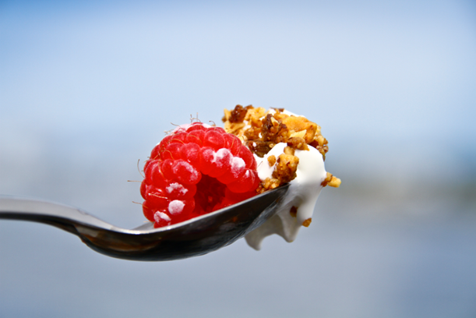
The core: food and beverages
Nordic
Healthy
Unique
Aesthetic
Story
Sustainable
Local
Nature

Slide 31
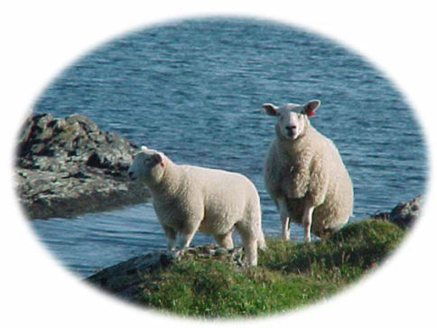
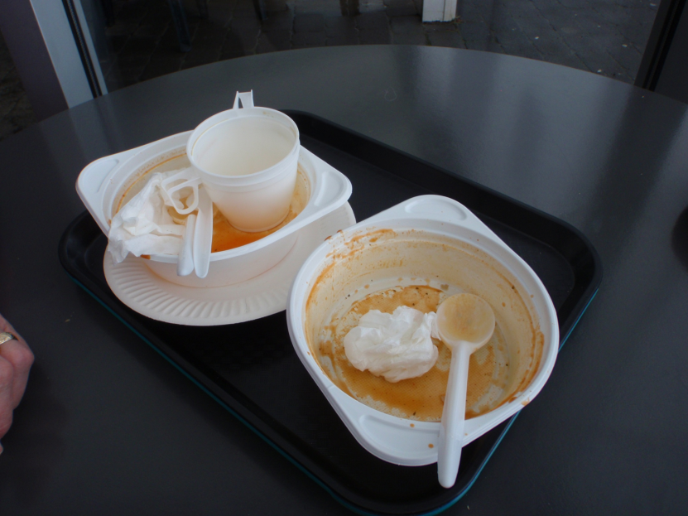
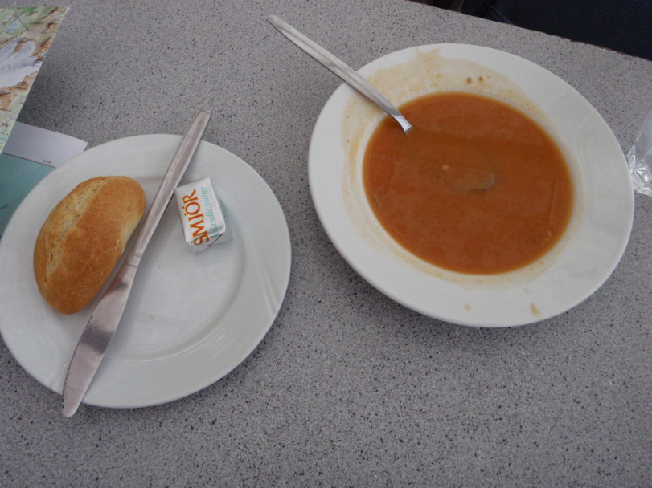
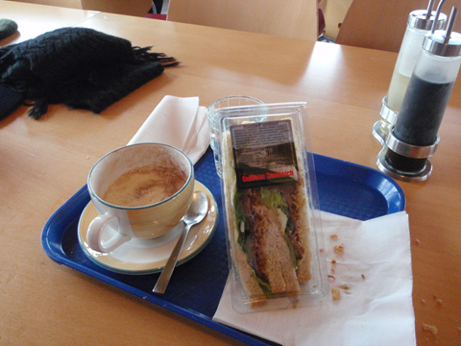
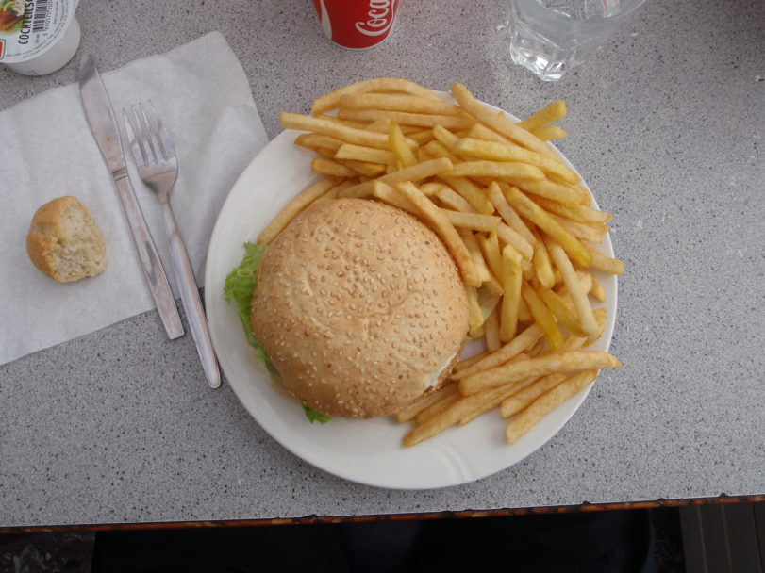
Iceland on the road…

Slide 32
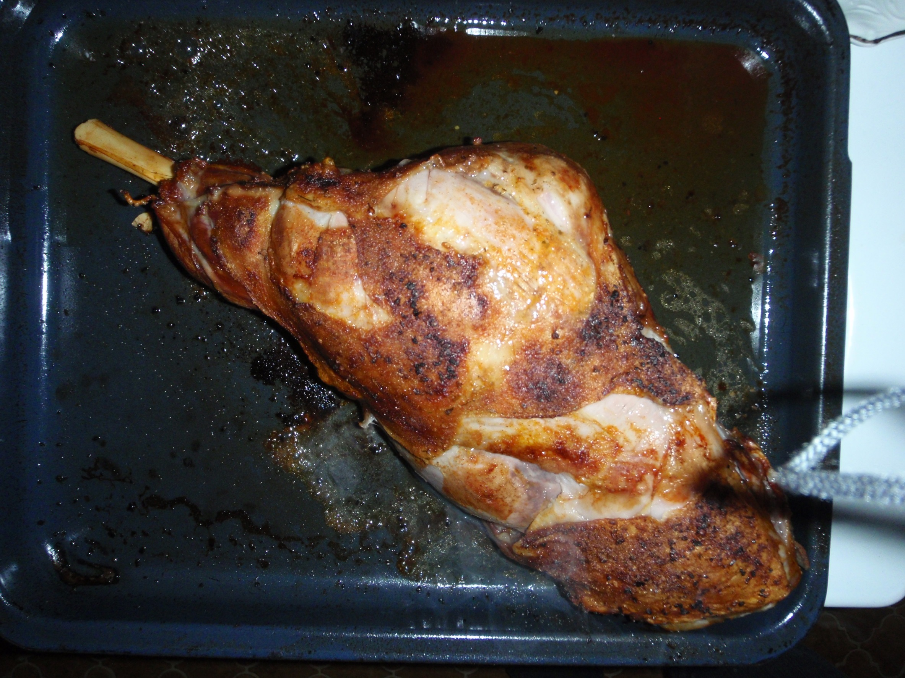
Finally, as guest in Ingas private home in Holar…

Slide 33
Sustainable management

Slide 35
(Vujicic, Getz & Robinson, 2013)

Slide 36
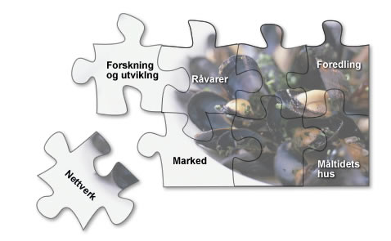
Can Iceland become a food and meal destination?
An area attracting both “foodies” and ordinary travellers
Must have
dedicated suppliers believing in their products
Easily available “meal routes” and experiencescapes
Known for interesting food and meal experience
Must conceive of one self as a food destination
MICE, arrangement and cruise
Use the tourists as ambassadors
Grühne Woche, shows and the Stavanger 2008-strategy

Slide 37
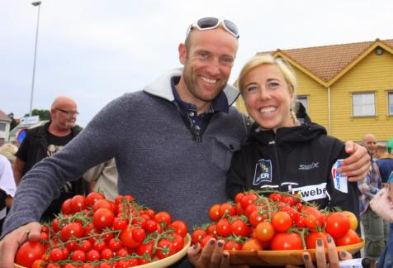
Meal attractions
Attractions for “foodies”
Quality meals for all
Food and meal competence
Offer learning experiences within food and meals
Open to co-production of meals
Meeting chefs, farmers and other producers – follow the food chain from raw material to delicate meals

Slide 38
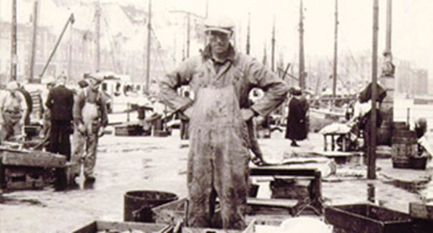
Yes – we can make it with the Meal Experience Model as a guide
The room, view, noise, cleanliness, atmosphere
The management
The meeting (staff competence)
The other guests
The food and beverages

