Slide 1
Tending to tourism Tourism’s role in thriving and declining communities
3rd Nordic Conference for Rural Research
Trondheim, Norway
8th – 10th September 2014.
Dr. Edward H. Huijbens
Director / Professor
Icelandic Tourism Research Centre / University of Akureyri
edward@unak.is

Slide 2
Regions of the EU Northern Periphery Programme
“Sparseness of population, rurality, insularity, harsh climate and peripherality” (NPP, 2011)

Slide 3
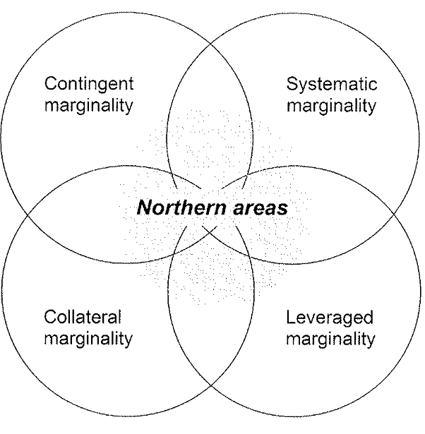
What is the rural?
… a historically specific construction composed of the discourses and realms of social relations, meanings and nature in a specific space
Saarinen, 2004: ‘Destinations in Change’: The Transformation Process of Tourist Destinations, p. 174.
Müller, 2011: Tourism Development in Europe’s Last Wilderness
In: Polar Tourism. A tool for Regional Development, p. 133

Slide 4
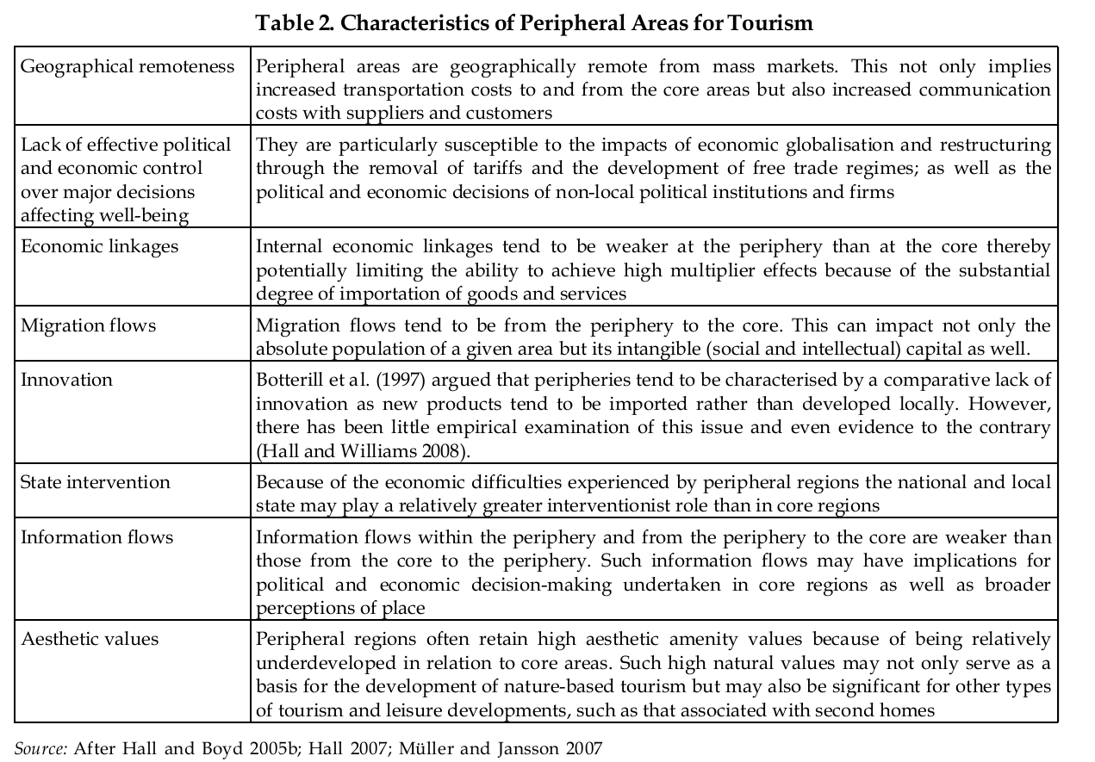
In Hall et.al., 2013: Vanishing peripheries, p. 76

Slide 5
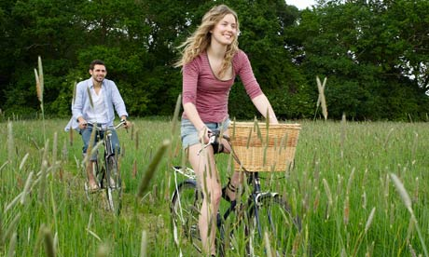
Tourism assets
Somewhere deep down in the early twenty-first century psyche there seem to remain a long-standing, handed-down precepts about rural areas, marking them as spaces enabled by nature, offering opportunities for living and lifestyle which are socially cohesive, happy, healthy, and presenting a pace and quality of life that differs from that in the city.
Cloke, 2003: Country Visions, p. 1
Country dwellers live longer, report on 'rural idyll' shows
Guardian, May 2010

Slide 6
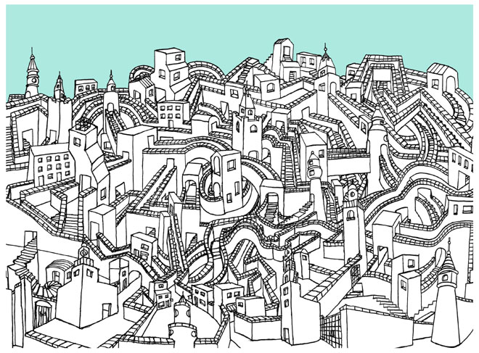
Relations of the rural
In Ersilia, to establish the relationships that sustain the city’s life, the inhabitants stretch strings from the corners of the houses, white or black or gray or black-and-white according to whether they mark a relationships of blood, of trade, authority, agency.
Calvino, 1976: Invisible Cities, p. 76
Neither space nor place can provide a haven from the world. If time presents us with the opportunities of change and (as some would see it) the terror of death, then space presents us with the social in the widest sense: the challenge of our constitutive interrelatedness – and thus our collective implication in the outcomes of that interrelatedness; the radical contemporaneity of an ongoing multiplicity of others, human and non-human; and the ongoing and ever-specific project of the practices through which that sociability is to be configured.
Massey, 2005: For Space, p. 195

Slide 7
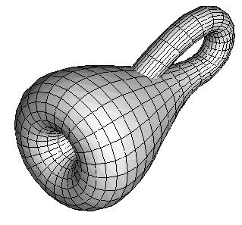
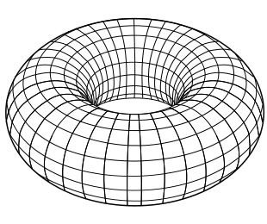
Rural Topology?
Prasolov, 1995: Intuative Topology, p. 4

Slide 8
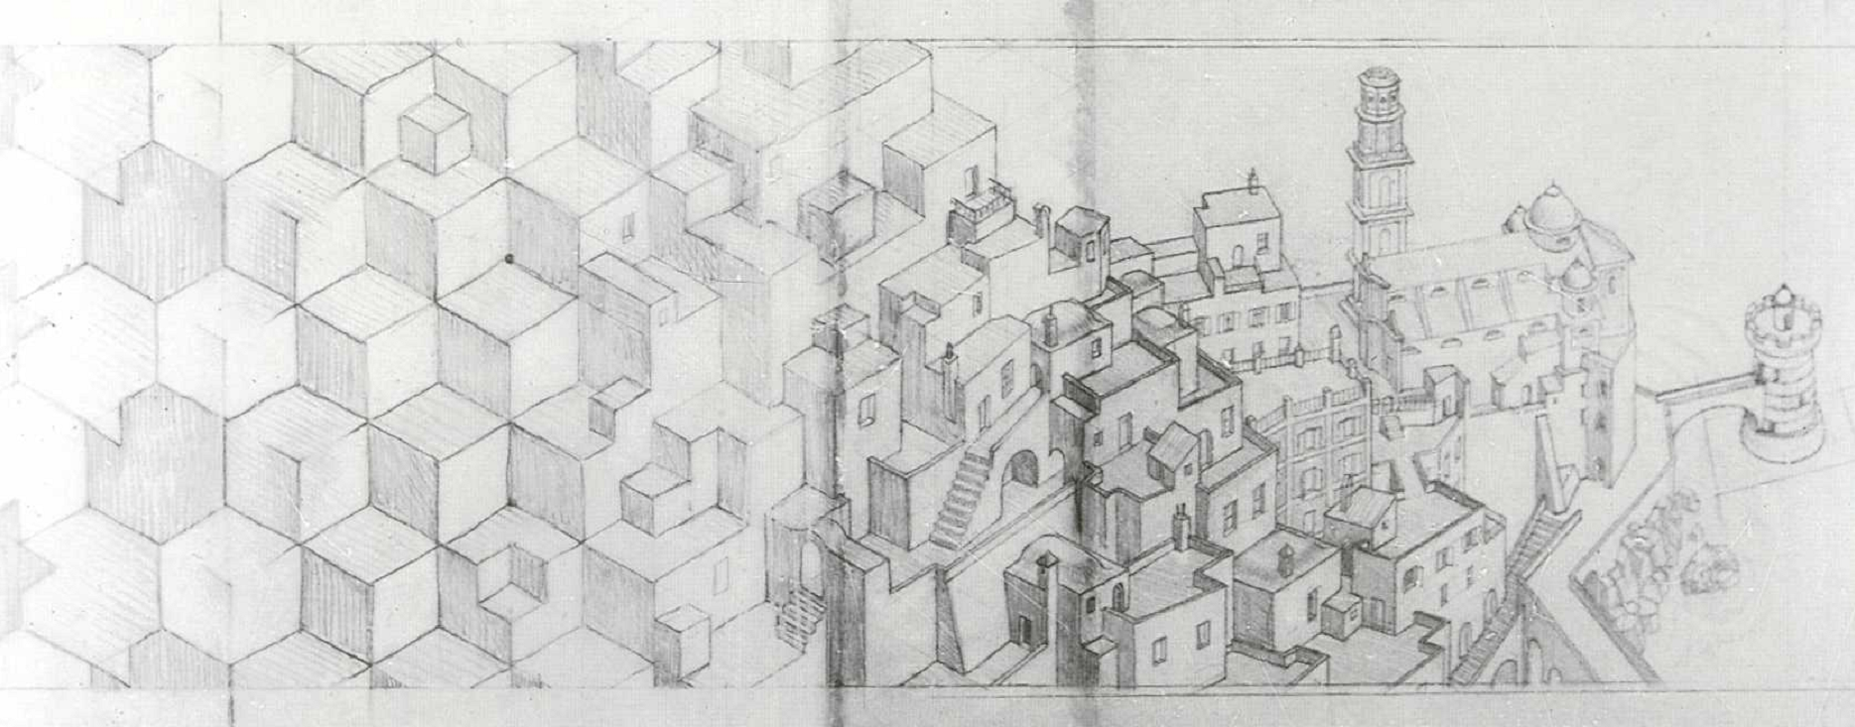
Emergent ruralities
‘’Topologica,’ replied the Space Hopper, ‘the Rubber-sheet Continent, which doesn’t so much drift as stretch … We have entered the realm of topology, from which rigidity was long ago banished and only continuity holds sway. The land of topological transformations, which can bend-and-stretch-and-compress-and-distort-and-deform’ (he said this all in one breath) “but not tear or break”
Stewart, 2001: Flatterland, p.89.

Slide 9
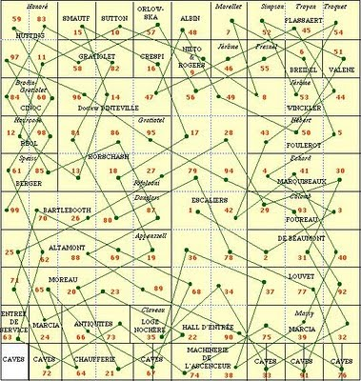
Sorting, listing, naming …
… the element’s existence does not precede the existence of the whole, it comes neither before nor after it, for the parts do not determine the pattern, but the pattern determines the parts: …
Perec, 1987[1978]: Life A User’s Manual, preamble

Slide 10
A function of relations
It is possible to identify those general characteristics which facilitate tacit knowledge transfer, such as multiple networks, across space and sectors, openness and cosmopolitanism. These, however, need to be translated into business strategies and speciﬁc practices such as recruitment, human resource management, supplier chain management, and customer relationships
Shaw and Williams, 2009: Knowledge Transfer and Management in Tourism Organisations, p. 333.

Slide 11
Hyping relationality
So, growth derives from creativity and therefore it is creative that make growth; growth can only occur if the creative come, and the creatives will only come if they get what they want; what the creative want is tolerance and openness, and if they find it, they will come; and if they come, growth will follow …
Rather than ‘civilising’ urban [regional] economic development by ‘bringing in culture’, creativity strategies do the opposite: they commodify the arts and cultural resources, even social tolerance itself, suturing them as putative economic assets to evolving regimes of urban [place based] competition
Peck, 2005: Struggling with the Creative Class, p. 757 and 763

Slide 12
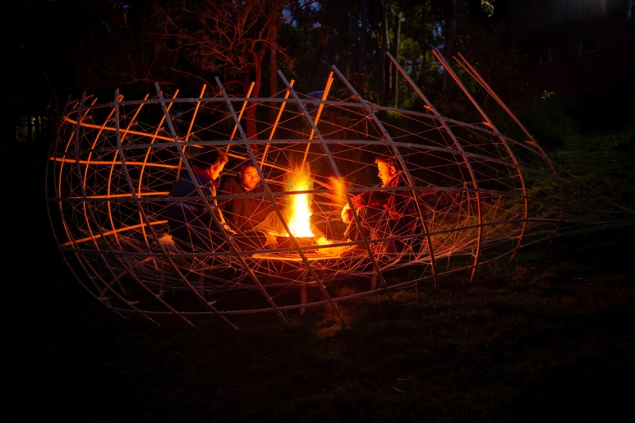
Ordering tourism – weaving the rural
Tourism orders both the spaces of tourism, including the sites that are visited and the spaces of mobility that get them there but also, the tourists themselves. They become self-ordering, self-directed tourists constantly interpellated by, and curious for the places that have been opened up in their name and which become relevant to them.
Franklin, 2004: Tourism as an ordering: Towards a new ontology of tourism, p.280

Slide 13
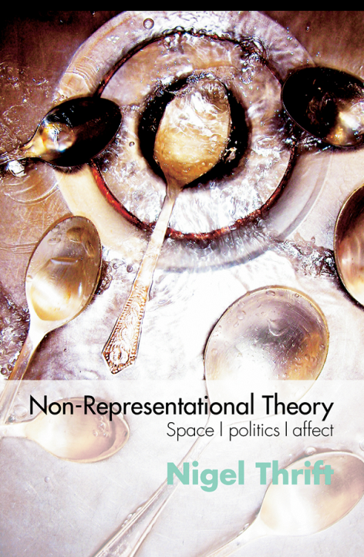
Countering forcefulness
We are our technologies, our tastes, our lifestyles and brands, our literal spaces. These are constantly under deformation, always a different figure showing, yet having their topological equivalent the structures of meaning comprise us as singular ‘rings of string’. Further, like foam, these are fragile and always threatening to burst…This is an imaginary in excess of function that drives media culture, consumer culture, and the knowledge and information society
Lash, 2012: Deforming the Figure: Topology and the Social Imaginary, p.271

